Slide 1
Unit - ii
Public -Key Cryptography

Slide 2
Approaches of Message Authentication
Encryption protects against passive attack (eavesdropping). A different requirement is to protect against active attack (falsification of data and transactions). Protection against such attacks is known as message authentication.
A message, file, document, or other collection of data is said to be authentic when it is genuine and comes from its alleged source. Message authentication is a procedure that allows communicating parties to verify that received messages areauthentic.1 The two important aspects are to verify that the contents of the message have not been altered and that the source is authentic.

Slide 3
Authentication Using Conventional Encryption
To perform authentication simply by the use of symmetric encryption. If we assume that only the sender and receiver share a key (which is as it should be), then only the genuine sender would be able to encrypt a message successfully for the other participant, provided the receiver can recognize a valid message. Furthermore, if the message includes an error-detection code and a sequence number, the receiver is assured that no alterations have been made and that sequencing is proper. If the message also includes a timestamp, the receiver is assured that the message has not been delayed beyond that normally expected for network transit.

Slide 4
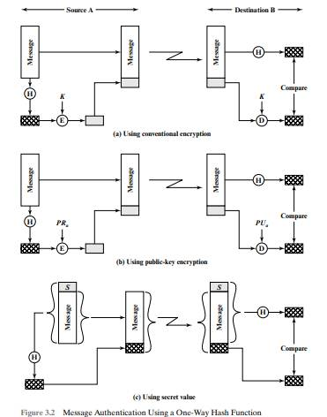
Contd…

Slide 5
Message Authentication without Message Encryption
There are a number of applications in which the same message is broadcast to a number of destinations. Two examples are notification to users that the network is now unavailable and an alarm signal in a control center.
Another possible scenario is an exchange in which one side has a heavy load and cannot afford the time to decrypt all incoming messages. Authentication is carried out on a selective basis with messages being chosen at random for checking.
Authentication of a computer program in plaintext is an attractive service. The computer program can be executed without having to decrypt it every time, which would be wasteful of processor resources.

Slide 6
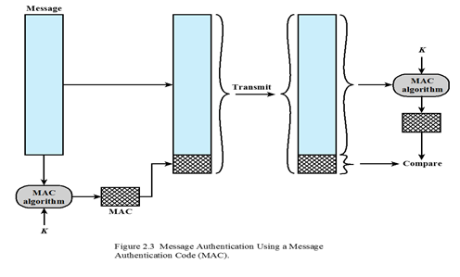
Contd…

Slide 7
md5
The MD5 message-digest algorithm is a cryptographic hash function designed to convert a message into a 128-bit hash value.
The output of MD5 (Digest size) is always 128 bits.

Slide 8
ALGORITHM
Append Padding Bits
Append Length Bits
Initialize MD buffer
Process Each 512-bit Block
Output

Slide 9
CONTD…
Append Padding Bits: In the first step, we add padding bits in the original message in such a way that the total length of the message is 64 bits less than the exact multiple of 512.
Suppose we are given a message of 1000 bits. Now we have to add padding bits to the original message. Here we will add 472 padding bits to the original message. After adding the padding bits the size of the original message/output of the first step will be 1472 i.e. 64 bits less than an exact multiple of 512 (i.e. 512*3 = 1536).

Slide 10
CONTD…
Append Length Bits: In this step, we add the length bit in the output of the first step in such a way that the total number of the bits is the perfect multiple of 512. Simply, here we add the 64-bit as a length bit in the output of the first step.

Slide 11
CONTD…
Initialize MD buffer: Here, we use the 4 buffers i.e. A B, C, and D. The size of each buffer is 32 bits.
- A = 0x67425301 - B = 0xEDFCBA45 - C= 0x98CBADFE - D = 0x13DCE476

Slide 12
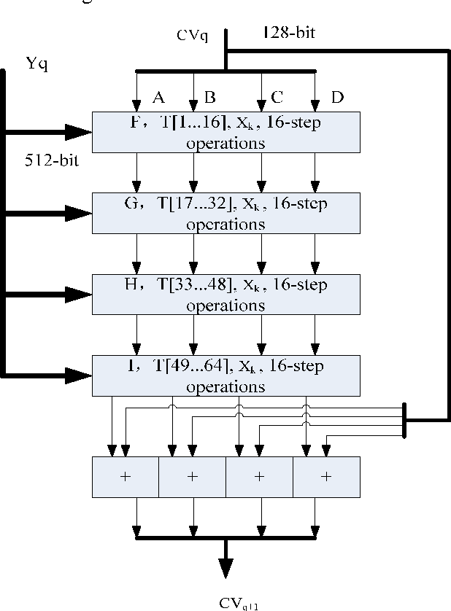
CONTD…

Slide 13
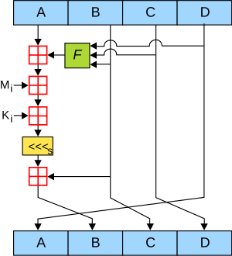
CONTD…

Slide 14
CONTD…
Process Each 512-bit Block: This is the most important step of the MD5 algorithm. Here, a total of 64 operations are performed in 4 rounds. In the 1st round, 16 operations will be performed, 2nd round 16 operations will be performed, 3rd round 16 operations will be performed, and in the 4th round, 16 operations will be performed. We apply a different function on each round i.e. for the 1st round we apply the F function, for the 2nd G function, 3rd for the H function, and 4th for the I function.

Slide 15
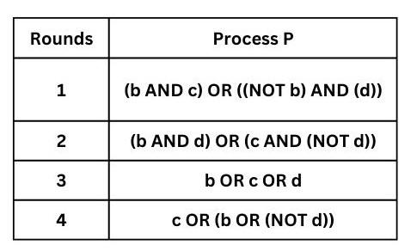
CONTD…
We perform OR, AND, XOR, and NOT (basically these are logic gates) for calculating functions. We use 3 buffers for each function i.e. B, C, D.

Slide 16
CONTD…
After applying the function now we perform an operation on each block. For performing operations we need
add modulo 2³²
M[i] – 32 bit message.
K[i] – 32-bit constant.
<<<n – Left shift by n bits.

Slide 17
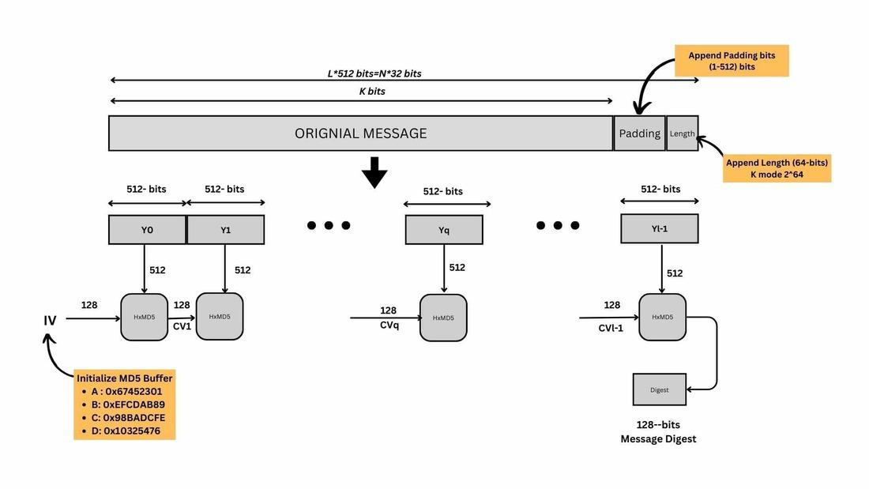
CONTD….

Slide 18
Secure Hash Functions (SHA-512)
Append padding bits: The message is padded so that its length is congruent to 896 modulo 1024 = [length 896 (mod 1024)]. Padding is always added, even if the message is already of the desired length. Thus, the number of padding bits is in the range of 1 to 1024.The padding consists of a single 1 bit followed by the necessary number of 0 bits.
Append length: A block of 128 bits is appended to the message. This block is treated as an unsigned 128-bit integer (most significant byte first) and contains the length of the original message (before the padding). The outcome of the first two steps yields a message that is an integer multiple of 1024 bits in length. In Figure 3.4, the expanded message is represented as the sequence of 1024-bit blocks M1, M2, . . ., MN, so that the total length of the expanded message is N × 1024 bits.

Slide 19
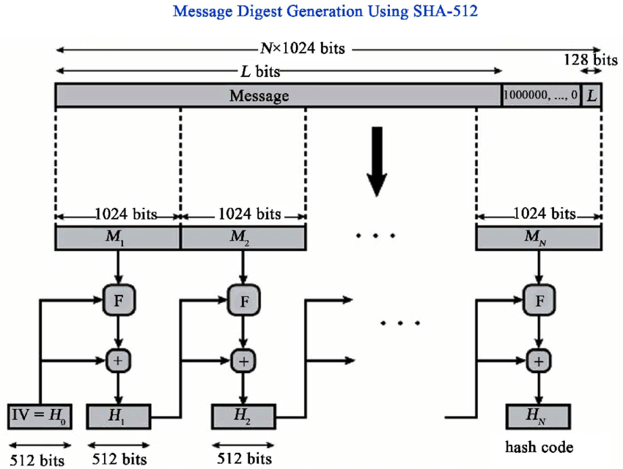
MD GENERATION USING SHA - 512

Slide 20
CONTD…
Initialize hash buffer: A 512-bit buffer is used to hold intermediate and final
results of the hash function. The buffer can be represented as eight 64-bit registers
(a, b, c, d, e, f, g, h).These registers are initialized to the following 64-bit
integers (hexadecimal values):
a = 6A09E667F3BCC908 e = 510E527FADE682D1
b = BB67AE8584CAA73B f = 9B05688C2B3E6C1F
c = 3C6EF372FE94F82B g =1F83D9ABFB41BD6B
d = A54FF53A5F1D36F1 h = 5BE0CD19137E2179

Slide 21
CONTD…
Process message in 1024-bit (128-word) blocks: The heart of the algorithm is a module that consists of 80 rounds; this module is labeled F in Figure 3.4.The logic is illustrated in Figure 3.5. Each round takes as input the 512-bit buffer value abcdefgh and updates the contents of the buffer. At input to the first round, the buffer has the value of the intermediate hash value, H_{i}. Each round t makes use of a 64-bit value W_{t} derived from the current 1024-bit block being processed (M_{i}). Each round also makes use of an additive constant K_{t} , where 0 … t … 79 indicates one of the 80 rounds. These words represent the first 64 bits of the fractional parts of the cube roots of the first 80 prime numbers. The constants provide a “randomized” set of 64-bit patterns, which should eliminate any regularities in the input data. The output of the 80th round is added to the input to the first round (H_{i-1}) to produce H_{i}. The addition is done independently for each of the eight words in the buffer with each of the corresponding words in H_{i-1} , using addition modulo 264.

Slide 22
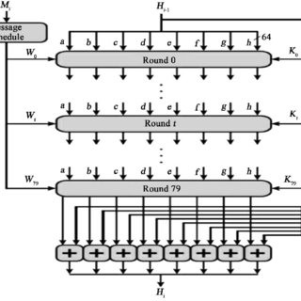
CONTD…

Slide 23
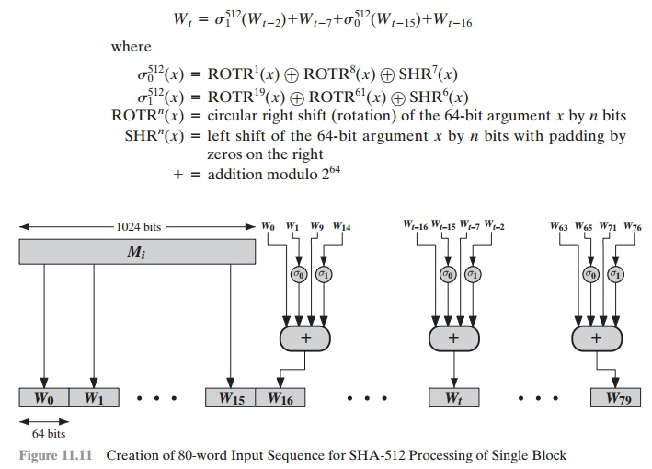
Word generator

Slide 24

PROCESSING OF BUFFERS…
T1 = h + Che (e,f,g) +( $\sum_{1}^{512}{e }$)+ W_{t} + K_{t}
T2 = ( $\sum_{0}^{512}{a }$) + Maj(a,b,c)
h = g
g = f
f = e
e = d+T1
d = c
c = b
b = a
a = T1 + T2

Slide 25
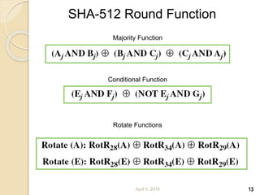
CONTD….

Slide 26
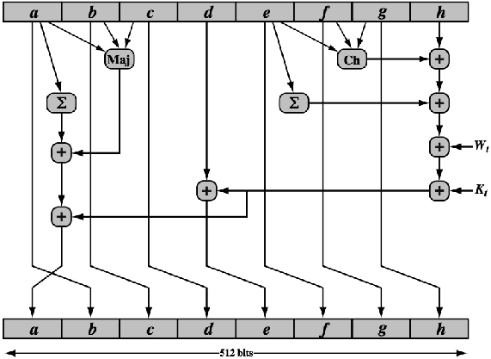
ROUND FUNCTION

Slide 27
CONTD…
Output: After all N 1024-bit blocks have been processed, the output from the Nth stage is the 512-bit message digest.

Slide 28
HMAC ALGORITHM
HMAC (Hash-based Message Authentication Code) is a type of message authentication code (MAC) that is acquired by executing a cryptographic hash function on the data that is to be authenticated and a secret shared key.
HMACs provides client and server with a shared private key that is known only to them. The client makes a unique hash (HMAC) for every request. When the client requests the server, it hashes the requested data with a private key and sends it as a part of the request. Both the message and key are hashed in separate steps making it secure. When the server receives the request, it makes its own HMAC. Both the HMACS are compared and if both are equal, the client is considered legitimate.

Slide 29
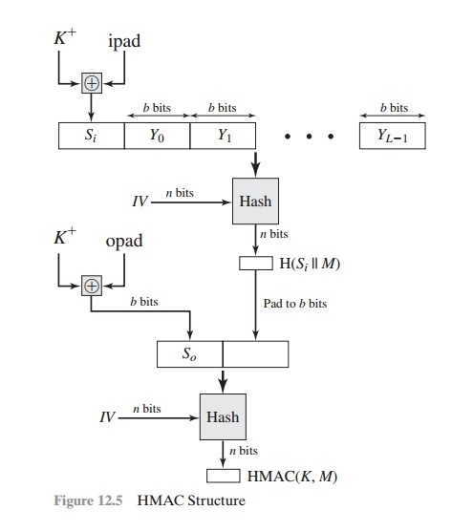
HMAC STRUCTURE

Slide 30
CONTD…
b = number of bits in a block
n = length of hash code produced by embedded hash function
K = secret key; if key length is greater than b, the key is input to the hash function to produce an n-bit key; recommended length is > n
K⁺ = K padded with zeros on the left so that the result is b bits in length
ipad = 00110110 (36 in hexadecimal) repeated b/8 times
opad = 01011100 (5C in hexadecimal) repeated b/8 times
Then HMAC can be expressed as
HMAC(K,M) = H[(K⁺ ⊕ opad) || H[(K⁺ ⊕ipad) || M]]

Slide 31
ALGORITHM
Append zeros to the left end of K to create a b-bit string K (e.g., if K is of length 160 bits and b = 512, then K will be appended with 44 zero bytes).
XOR (bitwise exclusive-OR) K with ipad to produce the b-bit block Si + .
Append M to Si.
Apply H to the stream generated in step 3.
XOR K⁺ with opad to produce the b-bit block S₀.
Append the hash result from step 4 to S_{0.}
Apply H to the stream generated in step 6 and output the result.

Slide 32
Public Key Cryptography principles
A public-key encryption scheme has six ingredients
Plaintext: This is the readable message or data that is fed into the algorithm as input.
Encryption algorithm: The encryption algorithm performs various transformations on the plaintext.
Public and private key: This is a pair of keys that have been selected so that if one is used for encryption, the other is used for decryption. The exact transformations performed by the encryption algorithm depend on the public or private key that is provided as input.
Cipher text: This is the scrambled message produced as output. It depends on the plaintext and the key. For a given message, two different keys will produce two different cipher texts.
Decryption algorithm: This algorithm accepts the cipher text and the matching key and produces the original plaintext.

Slide 33
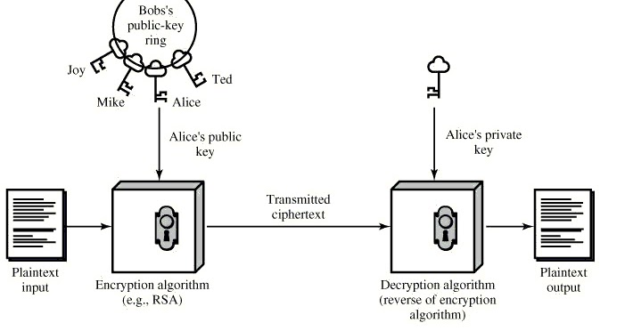
CONTD…

Slide 34
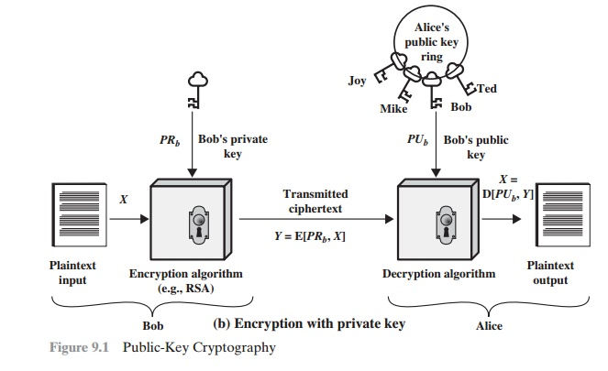
CONTD…

Slide 35
CONTD…
The essential steps are the following:
Each user generates a pair of keys to be used for the encryption and decryption of messages.
Each user places one of the two keys in a public register or other accessible file.
This is the public key. The companion key is kept private. Each user maintains a collection of public keys obtained from others.
If Bob wishes to send a private message to Alice, Bob encrypts the message using
Alice’s public key.
When Alice receives the message, she decrypts it using her private key. No other recipient can decrypt the message because only Alice knows Alice’s private key.

Slide 36
PUBLIC-KEY CRYPTOGRAPHY ALGORITHMS
RSA is a block cipher in which the plaintext and cipher text are integers between 0 and n - 1 for some n.
Encryption and decryption are of the following form period for some plaintext
block M and cipher text block C:
C = Me mod n
M = C^{d} mod n (Me)^{d} mod n M^{ed} mod n
Both sender and receiver must know the values of n and e, and only the receiver knows the value of d. This is a public-key encryption algorithm with a public key of KU = {e, n} and a private key of KR = {d, n}.

Slide 37
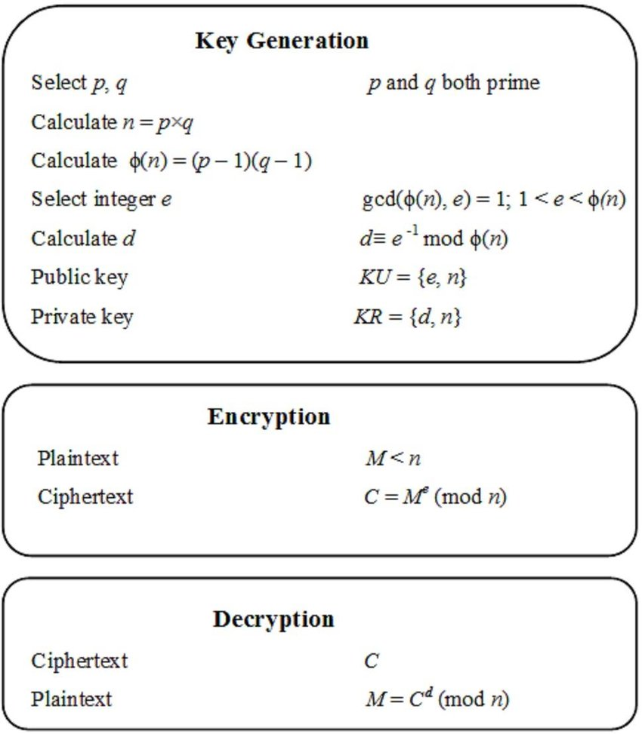
ALGORITHM

Slide 38
EXAMPLE
Select two prime numbers, p 17 and q 11.
Calculate n = pq = 17 × 11 = 187.
Calculate Ø(n) = (p - 1)(q - 1) = 16 × 10 = 160.
Select e such that e is relatively prime to Ø (n) = 160 and less than Ø (n); we choose e = 7.
Determine d such that de mod 160 = 1 and d < 160.The correct value is d = 23,because
23 × 7 = 161 = (1 × 160) + 1.
The resulting keys are public key PU = {7, 187} and private key PR = {23,187}.The example shows the use of these keys for a plaintext input of M = 88.

Slide 39
Diffie-Hellman Key Exchange
The purpose of the algorithm is to enable two users to exchange a secret key securely that then can be used for subsequent encryption of messages. The algorithm itself is limited to the exchange of the keys.

Slide 40
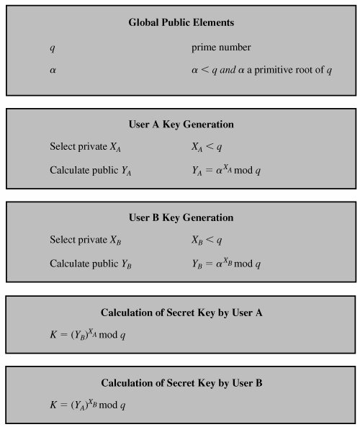
ALGORITHM

Slide 41
CONTD…
There are two publicly known numbers: a prime number q and an integer α that is a primitive root of q. Suppose the users A and B wish to exchange a key. User A selects a random integer X_{A} < q and computes Y_{A} = α^{X}_{A} mod q Similarly, user B independently selects a random integer X_{B} < q and computes Y_{B} = α^{X}_{B} mod q Each side keeps the X value private and makes the Y value available publicly to the other side. User A computes the key as K= (Y_{B})^{X}_{A} mod q and user B computes the key as K= (Y_{A})^{X}_{B} mod q.

Slide 42
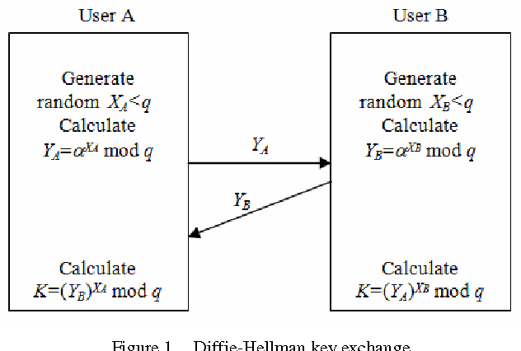
DH KEY EXCHANGE

Slide 43
MAN-IN-THE-MIDDLE ATTACK
Alice and Bob wish to exchange keys, and Darth is the adversary. The attack proceeds as follows:
Darth prepares for the attack by generating two random private keys X_{D1} and X_{D2}, and then computing the corresponding public keys Y_{D1} and Y_{D2}.
Alice transmits Y_{A} to Bob.
Darth intercepts Y_{A} and transmits Y_{D1} to Bob. Darth also calculates K2 = (Y_{A})^{XD2} mod q.
Bob receives Y_{D1} and calculates K1 = (Y_{D1})^{XB} mod q.
Bob transmits Y_{B} to Alice.
Darth intercepts Y_{B} and transmits Y_{D2} to Alice. Darth calculates K1 = (Y_{B})^{XD1} mod q.
Alice receives Y_{D2} and calculates K2 = (Y_{D2})^{XA} mod q.

Slide 44
Contd…
At this point, Bob and Alice think that they share a secret key. Instead Bob and Darth share secret key K1, and Alice and Darth share secret key K2. All future communication between Bob and Alice is compromised in the following way:
Alice sends an encrypted message M: E(K2,M).
Darth intercepts the encrypted message and decrypts it to recover M.
Darth sends Bob E(K1,M) or E(K1,M'), where M' is any message. In the first case, Darth simply wants to eavesdrop on the communication without altering it. In the second case, Darth wants to modify the message going to Bob.

Slide 45
Digital Signatures
When Alice sends a message to Bob, Bob needs to check the authenticity of the sender; he needs to be sure that the message comes from Alice and not Eve. Bob can ask Alice to sign the message electronically. In other words, an electronic signature can prove the authenticity of Alice as the sender of the message. We refer to this type of signature as a digital signature.

Slide 46
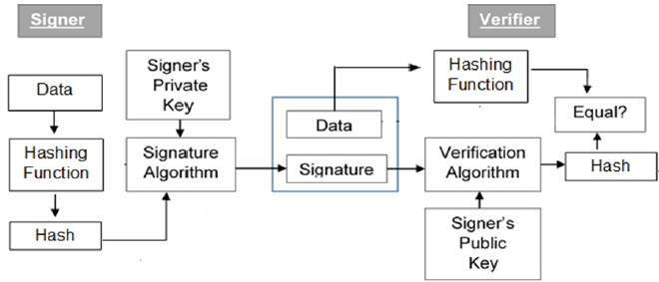
Structure of ds

Slide 47
Public Key Infrastructure
RFC 2822 (Internet Security Glossary) defines public-key infrastructure (PKI) as the set of hardware, software, people, policies, and procedures needed to create, manage, store, distribute, and revoke digital certificates based on asymmetric cryptography. The principal objective for developing a PKI is to enable secure, convenient, and efficient acquisition of public keys.

Slide 48
Contd…
These elements are
→ End entity: A generic term used to denote end users, devices (e.g., servers, routers), or any other entity that can be identified in the subject field of a public key certificate. End entities typically consume and/or support PKI-related services.
→ Certification authority (CA): The issuer of certificates and (usually) certificate revocation lists (CRLs). It may also support a variety of administrative functions, although these are often delegated to one or more registration authorities.
→ Registration authority (RA): An optional component that can assume a number of administrative functions from the CA. The RA is often associated with the end entity registration process, but can assist in a number of other areas as well.

Slide 49
Contd…
→ CRL issuer: An optional component that a CA can delegate to publish CRLs.
→ Repository: A generic term used to denote any method for storing certificates and CRLs so that they can be retrieved by end entities.

Slide 50
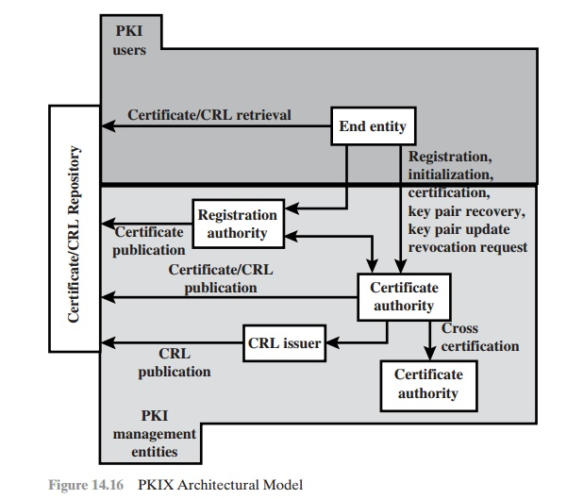
architecture

Slide 51
PKIX Management Functions
Registration
Initialization
Certification
Key pair recovery
Key pair update
Revocation request
Cross certification

Slide 52
Digital certificate
Digital certificate is issued by a trusted third party which proves sender’s identity to the receiver and receiver’s identity to the sender. A digital certificate is a certificate issued by a Certificate Authority (CA) to verify the identity of the certificate holder. Digital certificate is used to attach public key with a particular individual or an entity.

Slide 53
Contd…
Digital certificate contains
→ Name of certificate holder.
→ Serial number which is used to uniquely identify a certificate, the I individual or the entity identified by the certificate
→ Expiration dates.
→ Copy of certificate holder’s public key.(used for decrypting messages and digital signatures)
→ Digital Signature of the certificate issuing authority.

Slide 54
Key Management
Symmetric-key cryptography is more efficient than asymmetric-key cryptography for enciphering large messages. Symmetric-key cryptography, however, needs a shared secret key between two parties.
If Alice needs to exchange confidential messages with N people, she needs N different keys. What if N people need to communicate with each other? A total of N(N − 1) keys is needed if we require that Alice and Bob use two keys for bidirectional communication; only N(N − 1)/2 keys are needed if we allow a key to be used for both directions. This means that if one million people need to communicate with each other, each person has almost one million different keys; in total, almost one trillion keys are needed. This is normally referred to as the N² problem because the number of required keys for N entities is N².
The number of keys is not the only problem; the distribution of keys is another. If Alice and Bob want to communicate, they need a way to exchange a secret key; if Alice wants to communicate with one million people, how can she exchange one million keys with one million people?

Slide 55
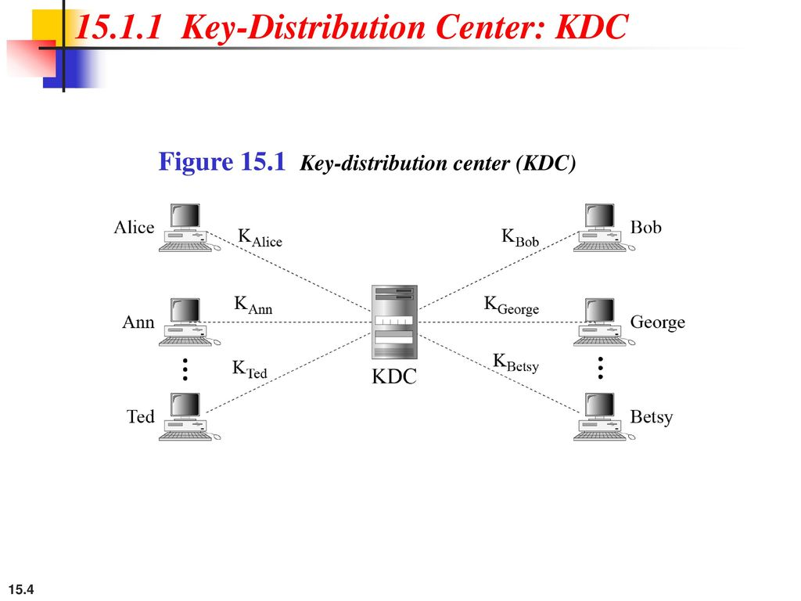
Key-Distribution Center: KDC
A practical solution is the use of a trusted third party, referred to as a key-distribution center (KDC). To reduce the number of keys, each person establishes a shared secret key with the KDC.

Slide 56
Contd…
A secret key is established between the KDC and each member. Alice has a secret key with the KDC, which we refer to as K_{Alice} ; Bob has a secret key with the KDC, which we refer to as K_{Bob} ; and so on. Now the question is how Alice can send a confidential message to Bob. The process is as follows:
Alice sends a request to the KDC stating that she needs a session (temporary) secret key between herself and Bob.
The KDC informs Bob about Alice’s request.
If Bob agrees, a session key is created between the two.

Slide 57
X.509 certificate
Although the use of a CA has solved the problem of public-key fraud, it has created a side-effect. Each certificate may have a different format. If Alice wants to use a program to automatically download different certificates and digests belonging to different people, the program may not be able to do this. One certificate may have the public key in one format and another in a different format. The public key may be on the first line in one certificate, and on the third line in another. Anything that needs to be used universally must have a universal format.

Slide 58
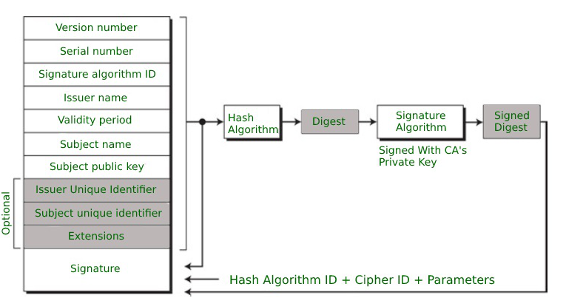
Certificate format

